Slide 1

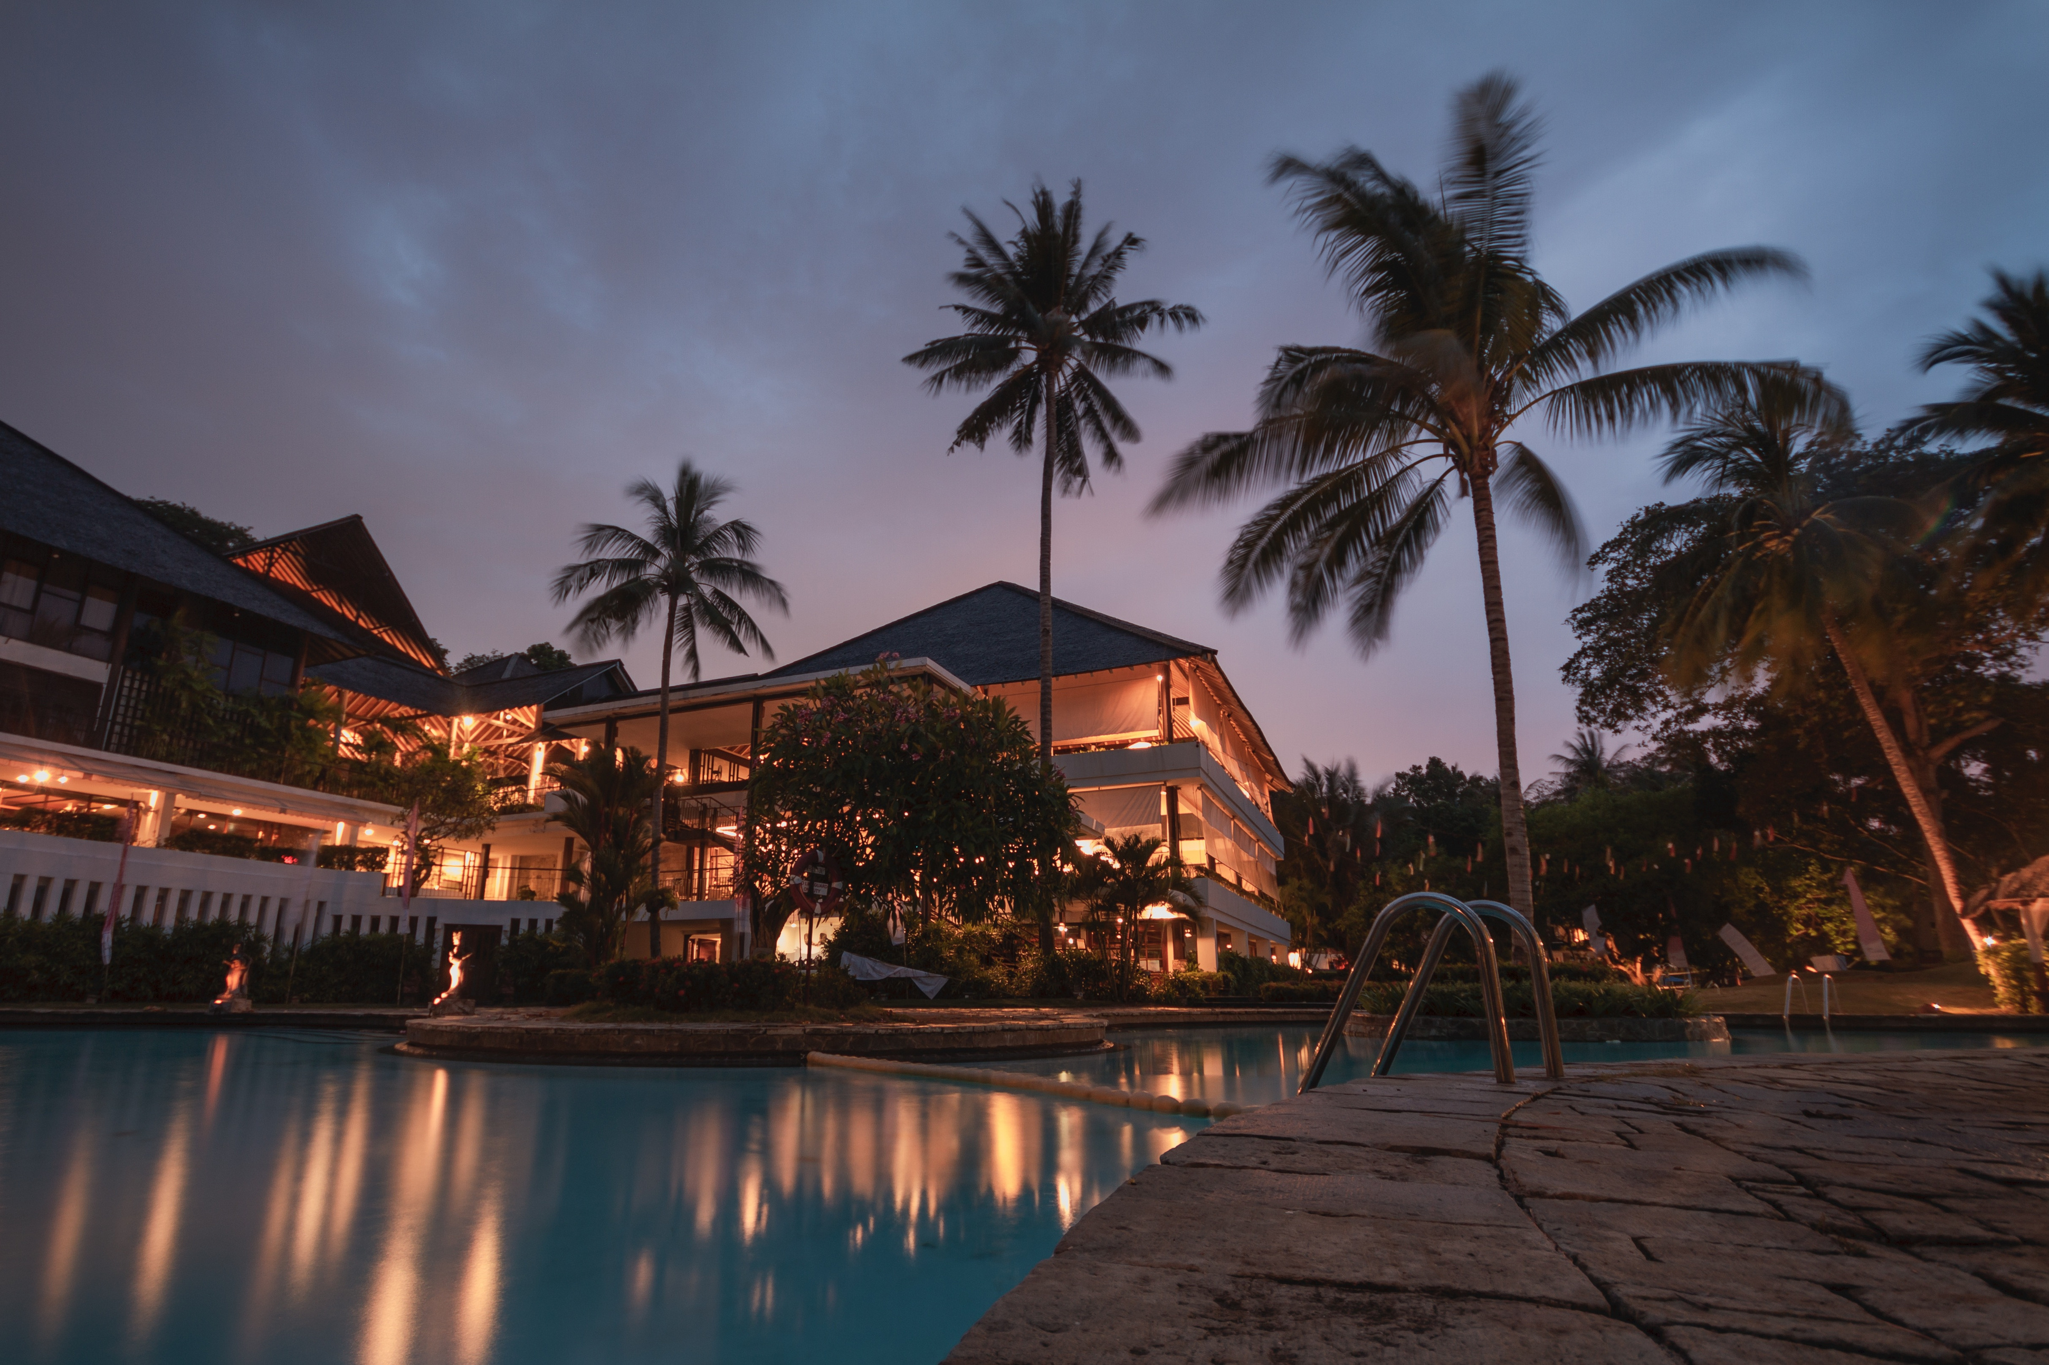
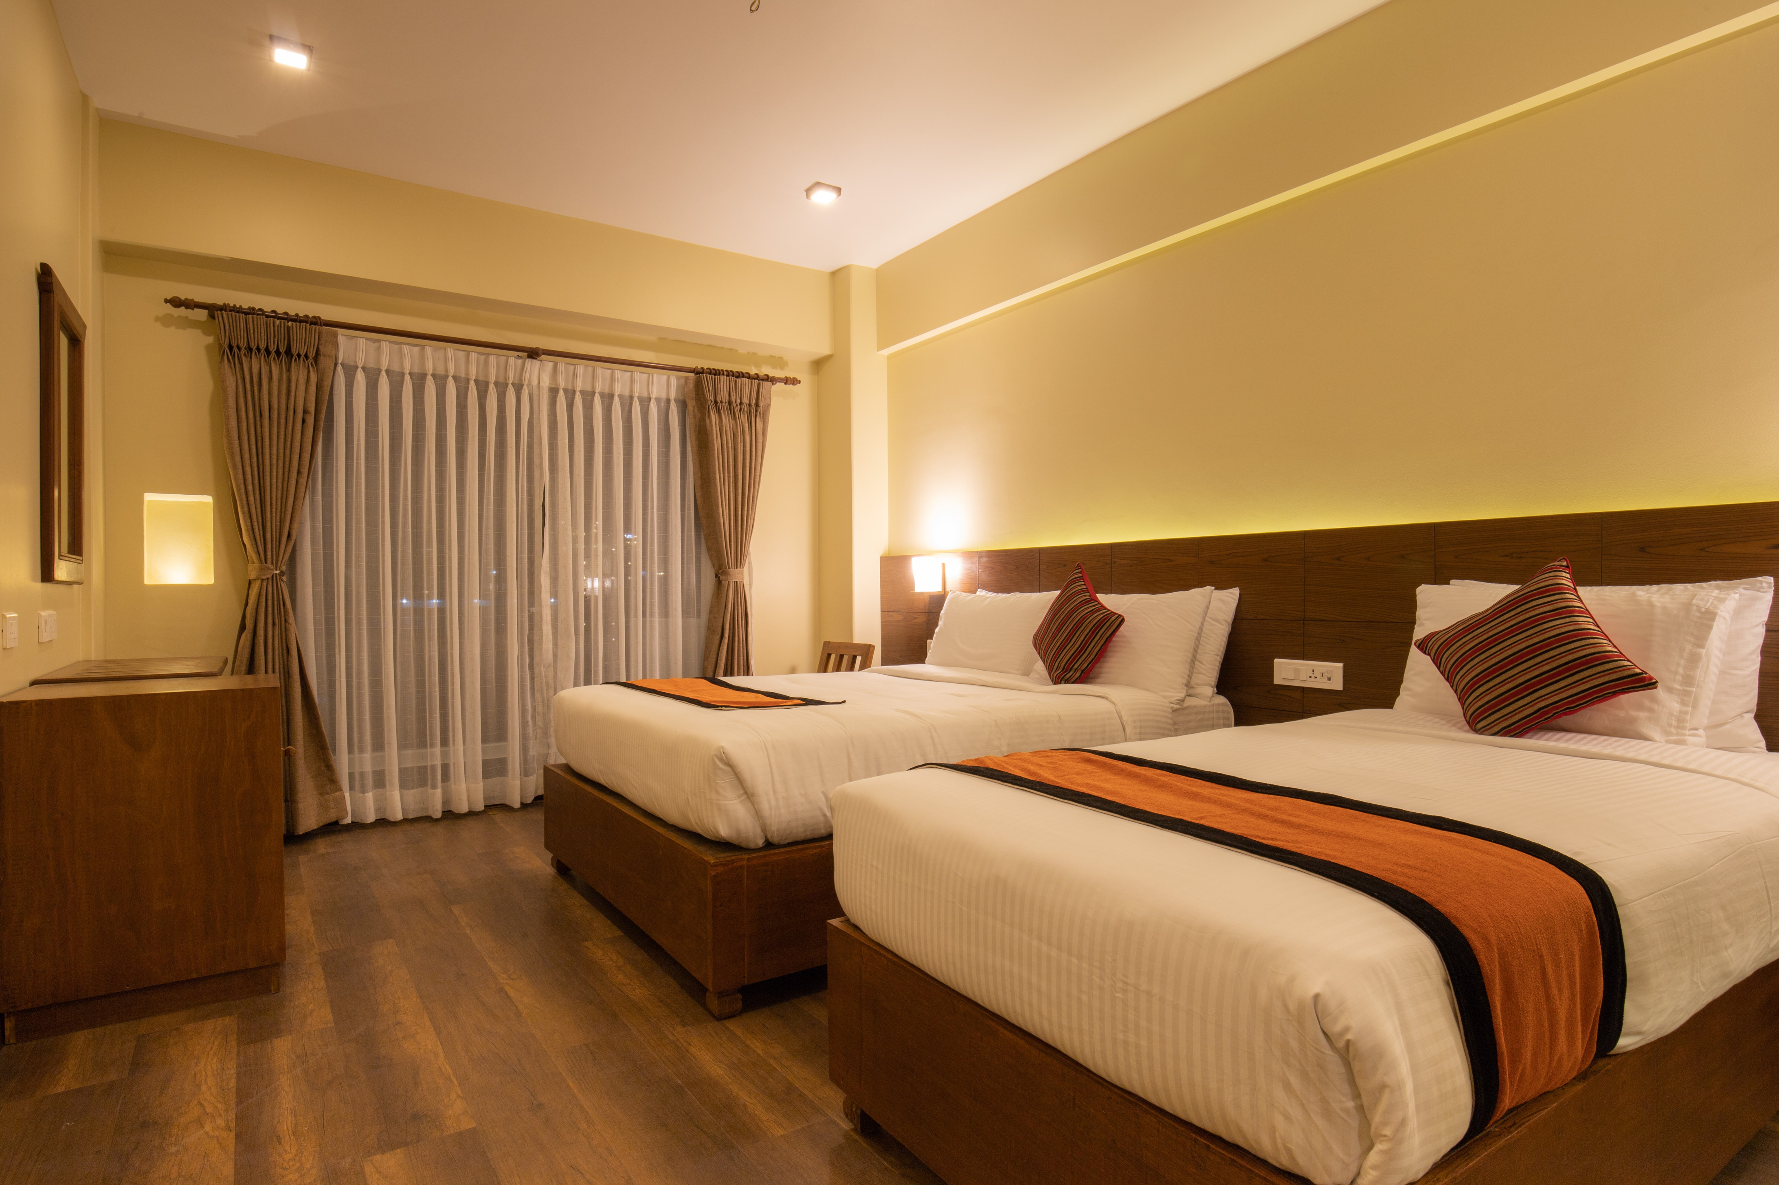

Atliq Grand
Hospitality Project

Slide 2

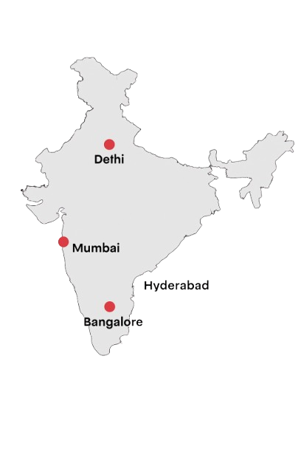
AtliQ Grands
AtliQ Grand has been serving in the hospitality industry for the past 20 years. It operates a chain of hotels across four major cities in India—Delhi, Bangalore, Mumbai, and Hyderabad.

Slide 3

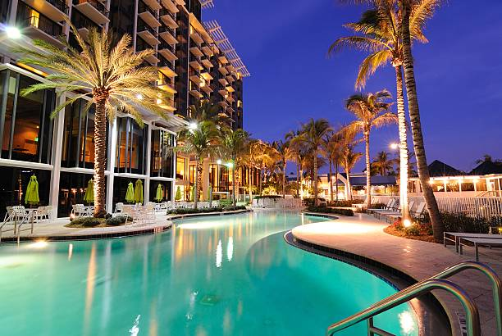
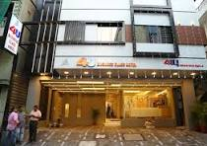
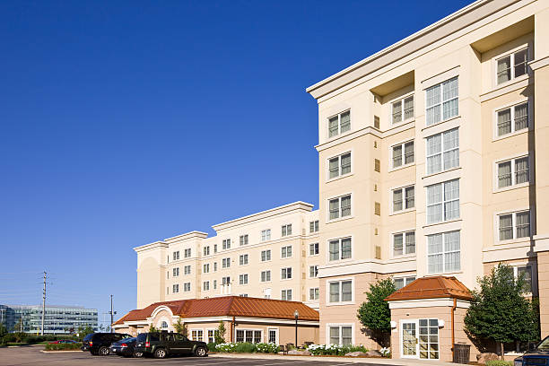
Hotel Categories
AtliQ Grands: Hotel Categories
AtliQ Bay
AtliQ Palace
AtliQ Season
AtliQ Exotica

Slide 4
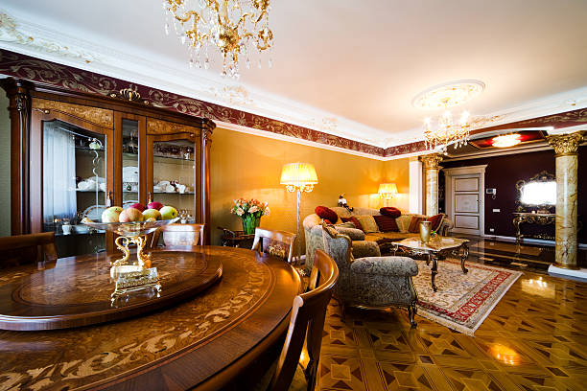
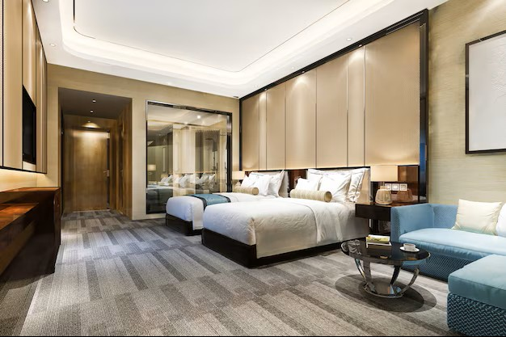
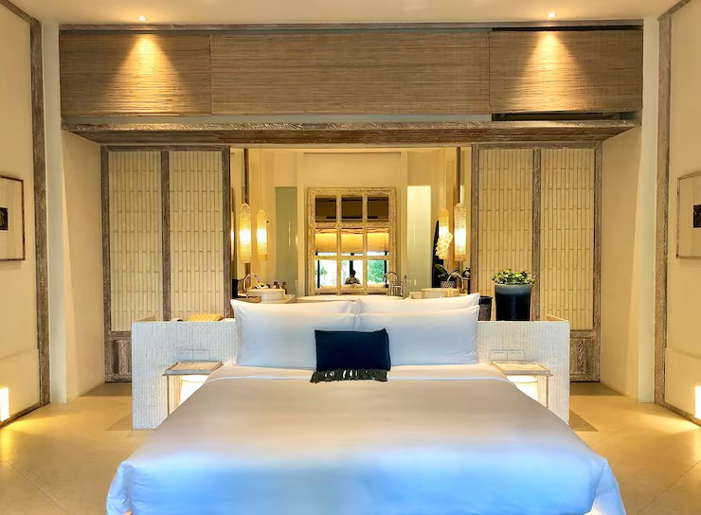
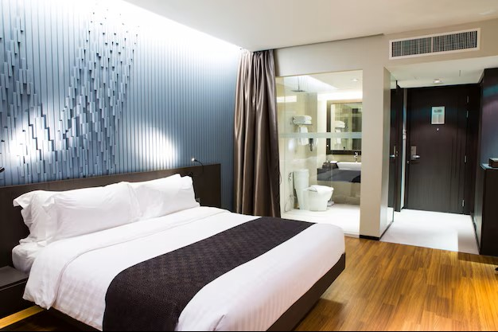
Room Categories
Presidential
Premium
Standard
Elite

Slide 5
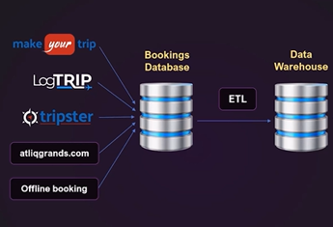

Data Set
1. Dim_date.csv
2. Dim_hotels.csv
3. Dim_rooms.csv
4. Fact_aggregated_bookings.csv
5. Fact_bookings.csv
6. New_data_august.csv

Slide 6
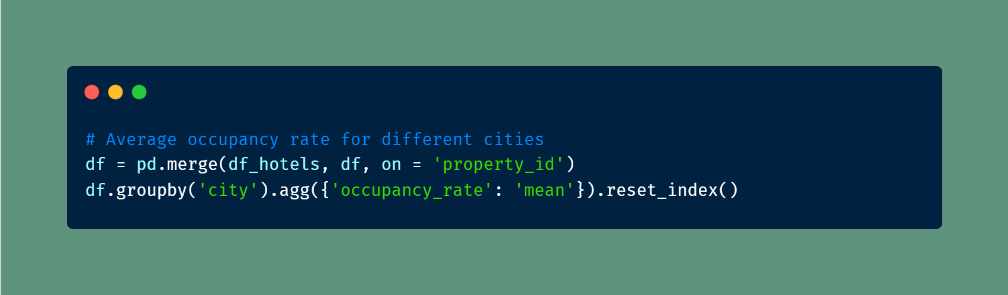
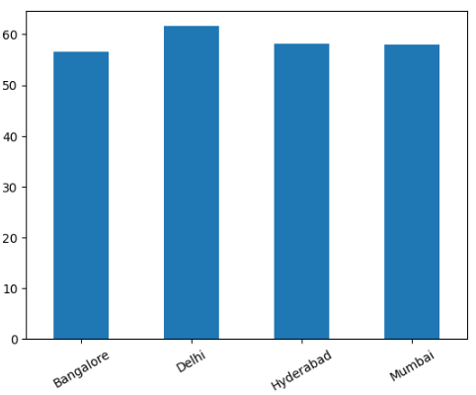
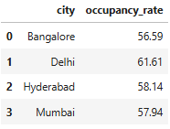
1. What is the occupancy rate for different cities?

Slide 7
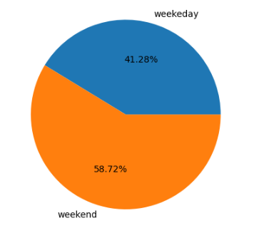
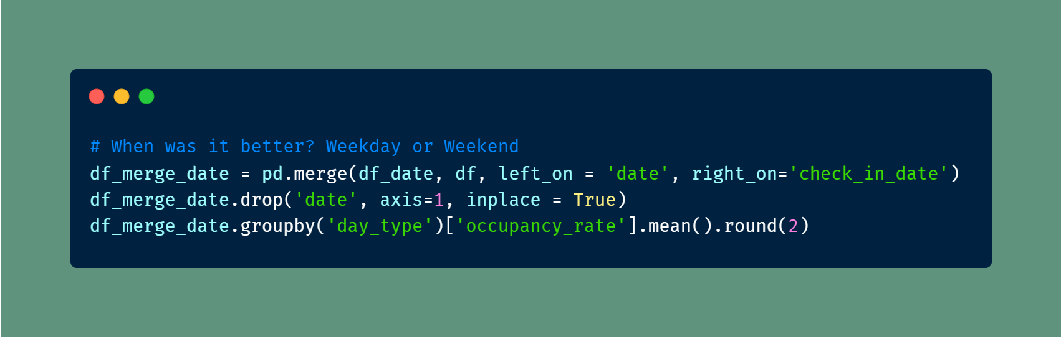
2. How does performance vary between weekdays and weekends, and which period demonstrates better results?

Slide 8
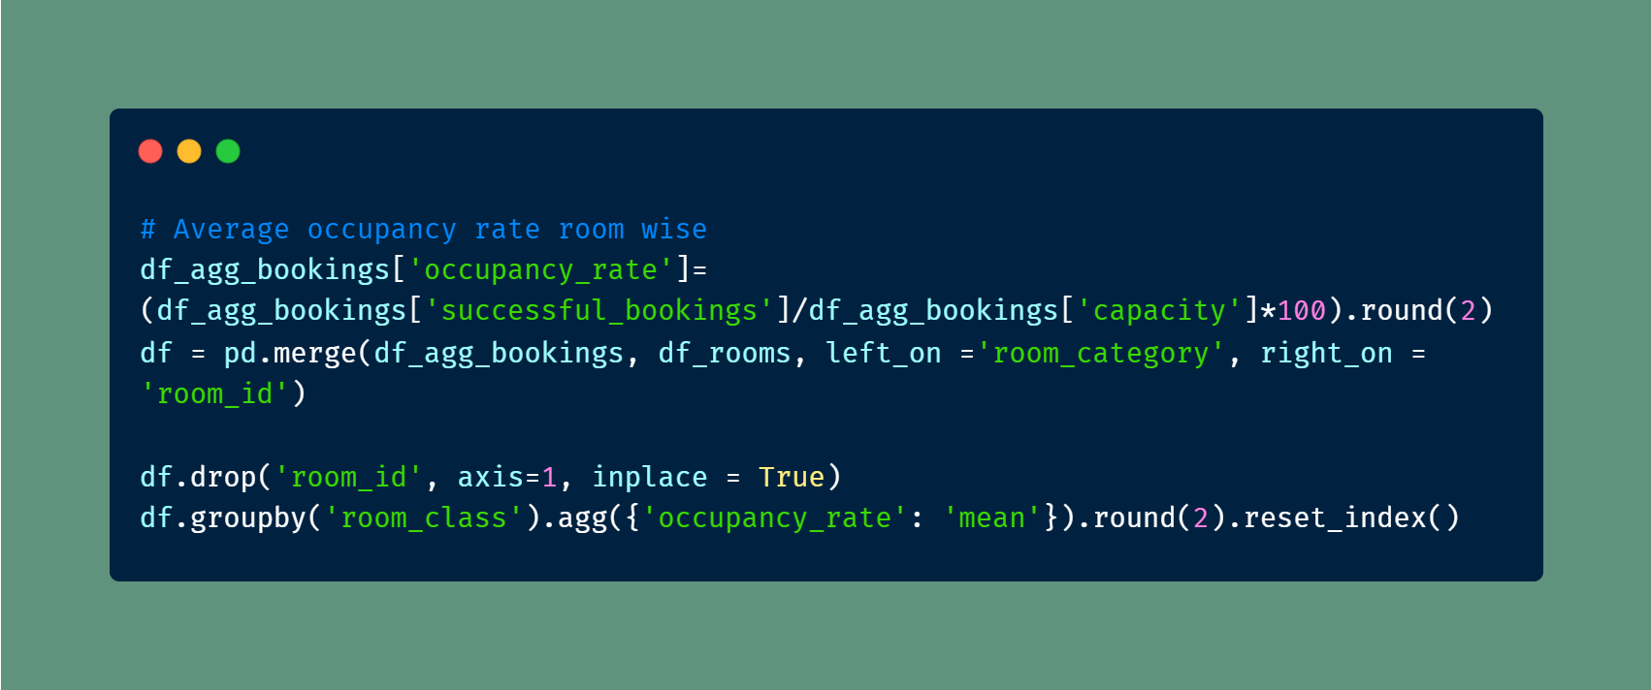
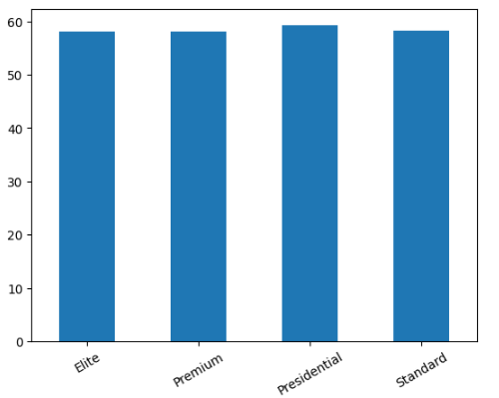
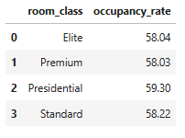
3. What is the average occupancy rate in each room categories?

Slide 9
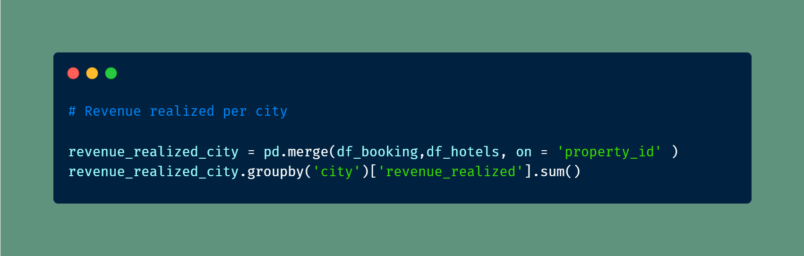
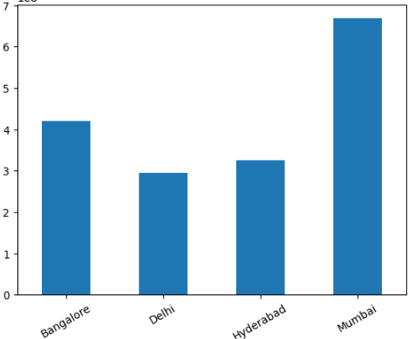
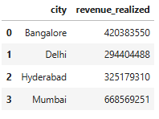
4. What is the Revenue realized per city?

Slide 10
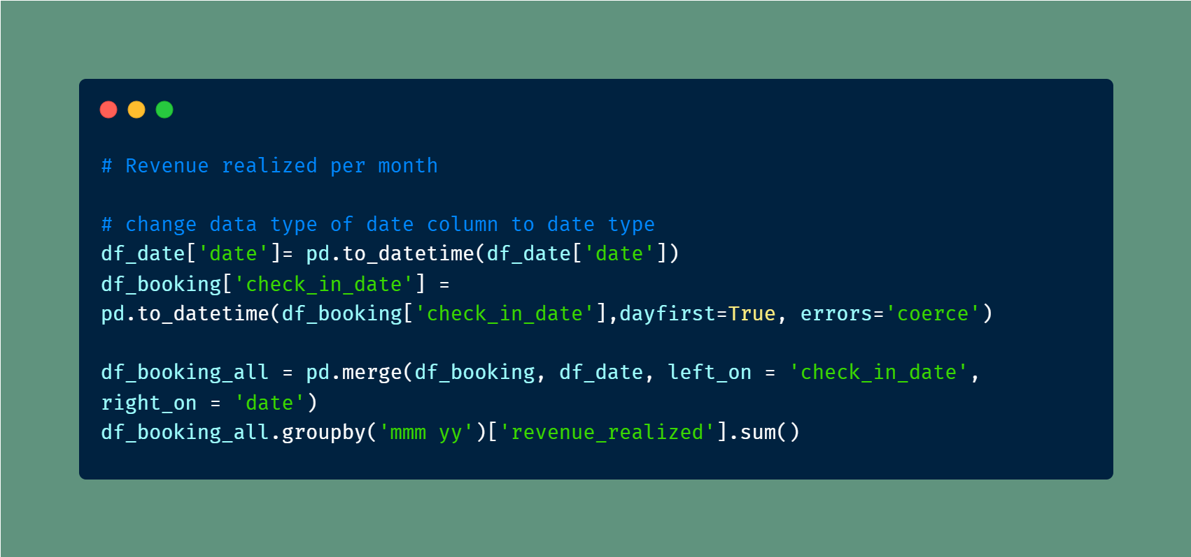
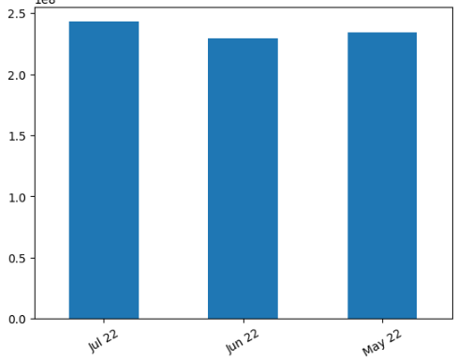
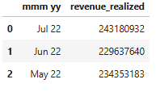
5. What is the monthly trend of revenue realized?

Slide 11
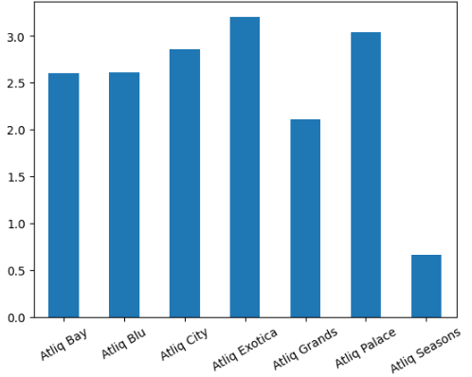
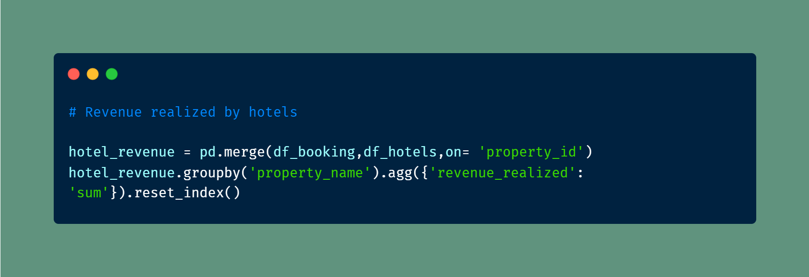
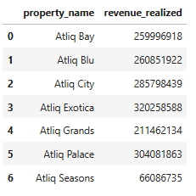
6.What is revenue realized by different hotels?

Slide 12
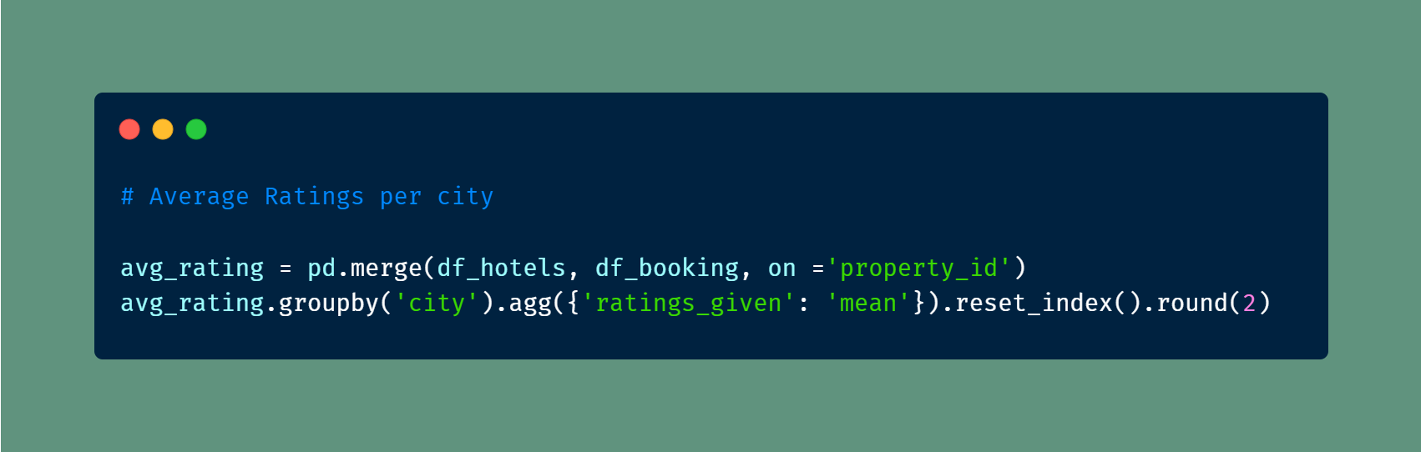
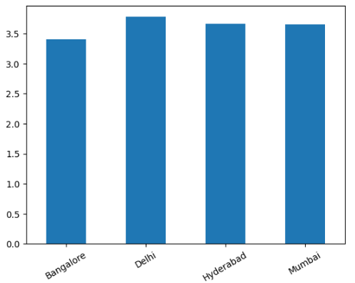
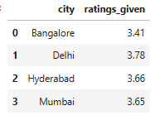
7. What is Average Ratings per city?

Slide 13




Thank You

